Slide 1

Age and Gender Detection in Masked Faces
Presented by (Group 22)
Syam sai akhil devarasetty
Kavya sri Turlapati
Kavya sree chowdary Kari

Slide 2
TABLE OF CONTENTS
INTRODUCTION
DATASET SUMMARY
IMPLEMENTATION
PERFORMANCE EVALUATION
RESULTS
CONCLUSION
FUTURE SCOPE
REFERENCES
Q/A

Slide 3
INTRODUCTION
Problem statement
The COVID-19 pandemic has highlighted the importance of face mask compliance in public spaces. However, traditional face detection models struggle to predict demographic traits such as age and gender when a face is partially covered by a mask. This project addresses the need for a solution that can detect whether an individual is wearing a face mask and simultaneously predict their age and gender, despite the occlusion of facial features caused by the mask.
Motivation
The COVID-19 pandemic emphasized the need for mask-wearing compliance to curb the spread of viruses. Traditional models often struggle with predicting age and gender when faces are partially covered. This project aims to address that gap by developing a solution that can detect masks and predict demographic traits, enabling more robust AI systems for health monitoring and demographic analysis.
Notes:
Problem Statement: "During the COVID-19 pandemic, wearing face masks became really important for safety. However, when people wear masks, it's hard for computer systems to tell things like their age or gender because the mask covers part of their face. This project solves that problem by building a system that can figure out if someone is wearing a mask and also guess their age and gender, even if their face is covered.”
Motivation: "The pandemic showed us how important it is for everyone to wear a mask to help stop the spread of the virus. But, most systems that try to figure out things like age or gender don’t work well when a mask is involved. This project helps by creating a system that can still figure out these details, even when a mask is worn, which can be useful for things like public health and safety."

Slide 4
Objectives of the Project
Detect Face Masks: Build a model to identify if a person is wearing a face mask.
Predict Age and Gender: Predict the age and gender of individuals even when their faces are partially covered.
Real-Time Detection: Create a live application that uses webcam input for real-time mask detection and demographic prediction.
Optimize for Efficiency: Ensure the models run efficiently on lower-end devices for real-time use.
Notes:
Detect Face Masks: "The goal is to build a system that can identify whether a person is wearing a mask or not."
Predict Age and Gender: "The system will predict a person’s age and gender, even when their face is partially covered by a mask."
Real-Time Detection: "We are developing a live application that uses a webcam to detect masks and predict age and gender in real-time."
Optimize for Efficiency: "We aim to ensure that the system works efficiently, even on devices with lower processing power, for real-time use."

Slide 5
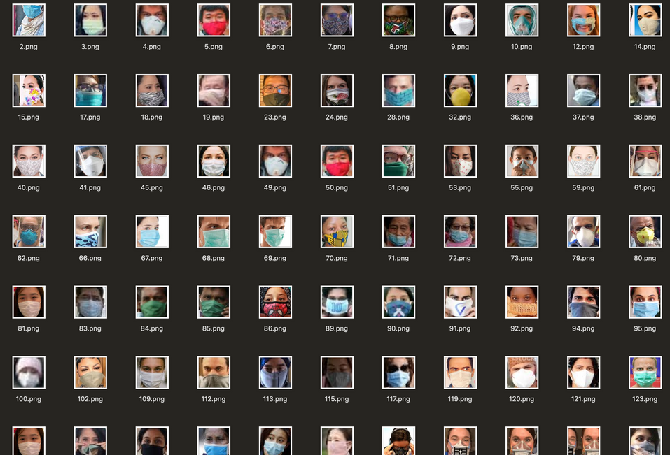
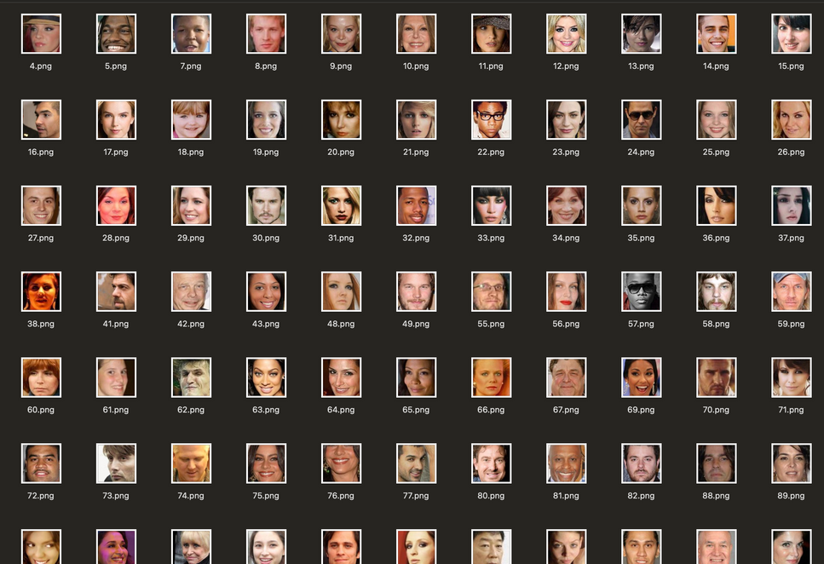
DATASET SUMMARY
Source: A private Kaggle dataset with 2,000 images (1,000 with masks and 1,000 without masks).
Image Variety: Includes different lighting, poses, and backgrounds, making it suitable for a generalized model.
Preprocessing: Images were resized to 224*224 pixels and normalized to improve model performance.
Challenges: The dataset is small, which limits generalization. Data augmentation was used, but expanding the dataset is needed for better performance
Fig1 With mask Fig2 Without mask
Notes:
Source: "We used a dataset from Kaggle with 2,000 images, half of which show people wearing masks and the other half without masks.”
Image Variety: "The dataset includes pictures with different lighting, angles, and backgrounds, which helps the model work well in real-life situations.”
Preprocessing: "We resized all the images to 224x224 pixels and adjusted them to improve the model's learning process.”
Challenges: "The dataset is small, which can make it harder for the model to learn all the patterns. We used data augmentation to improve it, but having more images would make the model even better."

Slide 6
IMPLEMENTATION
1. Dataset Loading and Preprocessing:
Loading the Dataset: The dataset consists of images with two classes "WithMask" and "WithoutMask" these images are loaded for training
Preprocessing:
The images are resized to 224*224 pixels to match the input size required by the CNN models
The images are then converted into arrays and normalized using the respective preprocessing functions for each model (MobileNet, VGG16, ResNet50, etc......)
And the one-hot encoding is applied to the labels ("WithMask" and "WithoutMask") to convert them into binary classes
Notes:
Loading the Dataset: "The dataset includes two categories: images of people with masks and without masks. We load these images to train the model.”
Preprocessing: "First, we resize the images to 224x224 pixels to match the required input size for our CNN models. Then, we convert the images into arrays and normalize them using preprocessing functions that are specific to each model (like MobileNet, VGG16, etc.).”
One-Hot Encoding: "The labels ('WithMask' and 'WithoutMask') are converted into binary classes using one-hot encoding, which helps the model understand and categorize the data better."

Slide 7
2. Model Selection:
The system supports multiple CNN models, including:
MobileNetV2: Chosen for its efficiency on edge devices
VGG16: Known for its simplicity and strong feature learning
ResNet50: Known for residual learning, which helps in training deep networks
InceptionV3 (GoogLeNet): Known for handling multiple scales of information
Based on the model type chosen (from CNN_TYPE), the corresponding model is selected using the get_cnn_mode() function
3. Model Modification and Customization:
The chosen CNN models (MobileNetV2, VGG16, ResNet50, or InceptionV3) are loaded with pre-trained weights, excluding the top layer. A global average pooling layer is added, followed by a Flatten layer, a Dense layer with 128 neurons, and a Dropout layer to prevent overfitting. The final Dense layer with 2 units and softmax activation classifies the output into Mask/No Mask.
Notes:
Model Selection: "We use several CNN models in this project:
MobileNetV2 is chosen for its efficiency, especially on devices with limited processing power.
VGG16 is known for its simplicity and effectiveness in learning important features from images.
ResNet50 is used for its ability to train deeper networks using residual learning.
InceptionV3 (GoogLeNet) is used for its ability to handle multiple scales of information at once.”
Model Modification and Customization: "After loading the chosen model (like MobileNetV2 or VGG16) with pre-trained weights, we add a few custom layers:
A Global Average Pooling layer to reduce the dimensionality.
A Flatten layer to convert the output into a 1D vector.
A Dense layer with 128 neurons for feature learning.
A Dropout layer to prevent overfitting during training.
The final Dense layer with 2 units and softmax activation classifies the images as ‘Mask’ or ‘No Mask’."

Slide 8
4.Model Compilation and Training:
The model is compiled using the Adam optimizer with a learning rate of 1e-4, which decays over time
Binary Cross-Entropy is used as the loss function for this binary classification task
To prevent overfitting and improve model robustness, data augmentation techniques like rotation, zoom, shifts, shear, and horizontal flips are applied
Then the model is trained for 100 epochs with a batch size of 32, tracking both training and validation accuracy to monitor generalization.
Save and load the trained model for real-time predictions
5.Real-Time Detection:
Face Detection:
A pre-trained SSD (Single Shot Multibox Detector) model based on Caffe used to detect faces in real-time video streams.
The detected face regions are extracted from the frame.
Mask Detection:
The extracted face regions are resized to 224x224 pixels.
The model (MobileNet etc...) predicts whether the person is wearing a mask or not.
Notes:
Model Compilation and Training: "The model is compiled using the Adam optimizer, which helps adjust the learning rate during training for faster learning. Then We have used Binary Cross-Entropy as the loss function since it's a binary classification task (mask vs. no mask). To prevent overfitting and make the model more robust, we apply data augmentation like rotating, zooming, and shifting the images. The model is trained for 100 epochs with a batch size of 32, and we track both training and validation accuracy to ensure the model is generalizing well. After training, we save the model so it can be used for real-time predictions.”
Real-Time Detection:
Face Detection: "We use a pre-trained SSD (Single Shot Multibox Detector) model based on Caffe to detect faces in real-time video streams. The detected face regions are extracted from the frame for further processing."
Mask Detection: "Once faces are detected, the extracted face regions are resized to 224x224 pixels. Then, the trained MobileNet model (or any chosen CNN model) is used to predict whether the person is wearing a mask or not."

Slide 9
3. Age and Gender Prediction:
After detecting faces, pre-trained Caffe models (AgeNet and GenderNet) are used.
AgeNet classifies the face into an age group (e.g.., 0-2, 4-6, 8-12, etc......)
GenderNet predicts the gender of the person whether Male or Female
Notes:
Age and Gender Prediction: "After detecting the face, we use pre-trained models called AgeNet and GenderNet to predict the person's age and gender."
AgeNet: "This model classifies the face into an age group, such as 0-2 years, 4-6 years, 8-12 years, and so on."
GenderNet: "This model predicts whether the person is Male or Female based on facial features."

Slide 10
PERFORMANCE EVALUATION
Model Comparison:
Various models, including MobileNetV2, VGG16, ResNet50, and InceptionV3, were tested for performance.
ResNet50 outperformed the others, achieving the highest accuracy of 99.99% due to its deep learning capabilities and residual connections.
In comparison, while VGG16, InceptionV3, and MobileNetV2 performed well, ResNet50's accuracy and deeper network architecture made it the most suitable for this task.
2. Model Performance Summary:
Got 99.9% accuracy, demonstrating high overall model performance.
Sensitivity (100%) and Specificity (100%) highlight the model’s ability to correctly identify both "WithMask" and "WithoutMask" cases.
ROC Curve & AUC: AUC of 0.99 reflects excellent model discrimination between the classes.
Notes:
"We tested several models, and ResNet50 performed the best, achieving the highest accuracy of 99.99% due to its deep learning capabilities
and residual connections.
While VGG16, InceptionV3, and MobileNetV2 performed well, ResNet50's deeper architecture and accuracy made it the most suitable for this task."

Slide 11
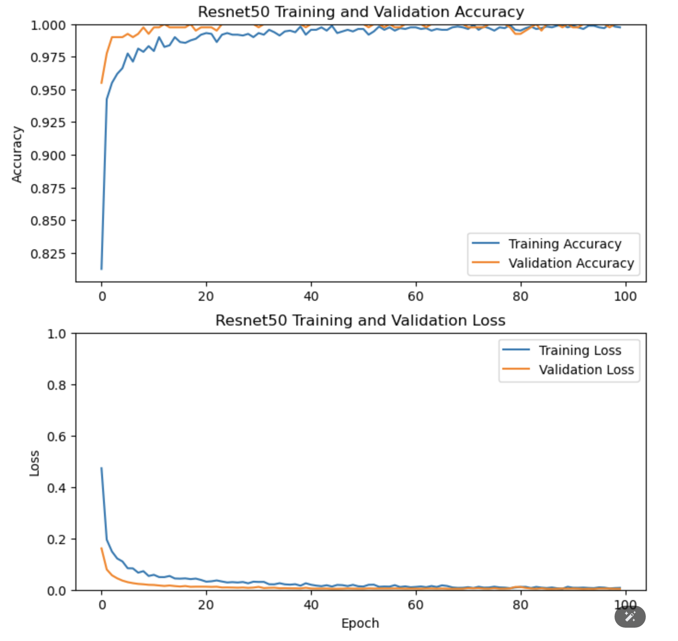
Fig 3 Accuracy & Loss comparision Graph
Notes:
Accuracy Graph: "This graph shows how well the model performed during training and validation. The training accuracy (blue line) increases quickly, while the validation accuracy (orange line) also increases but starts to stabilize, showing that the model is learning well from the training data.”
Loss Graph: "The training loss (blue line) decreases significantly over time, meaning the model is getting better at making predictions. The validation loss (orange line) also decreases, showing that the model is not overfitting and generalizing well to unseen data."

Slide 12
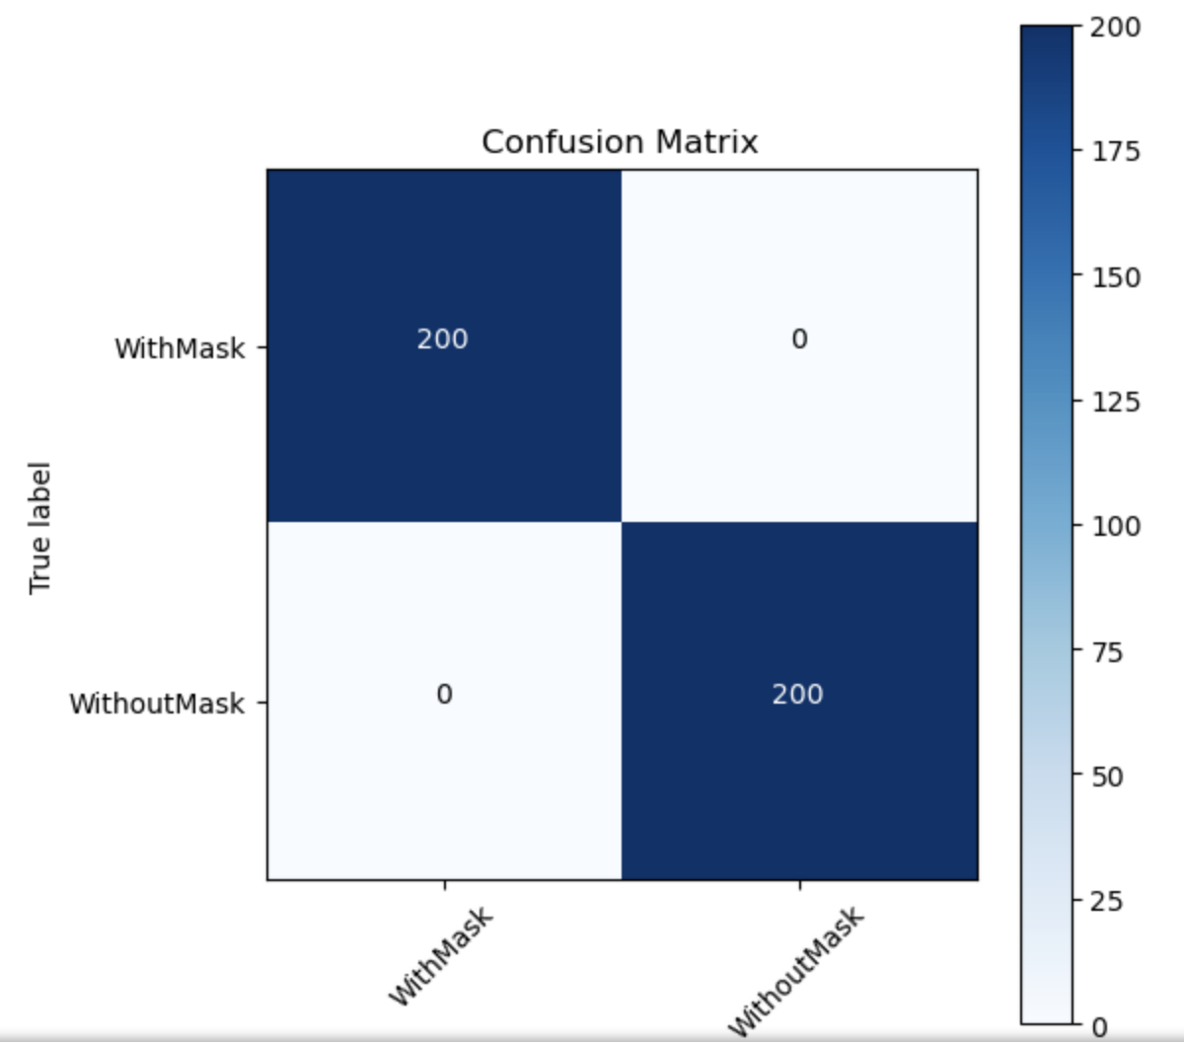
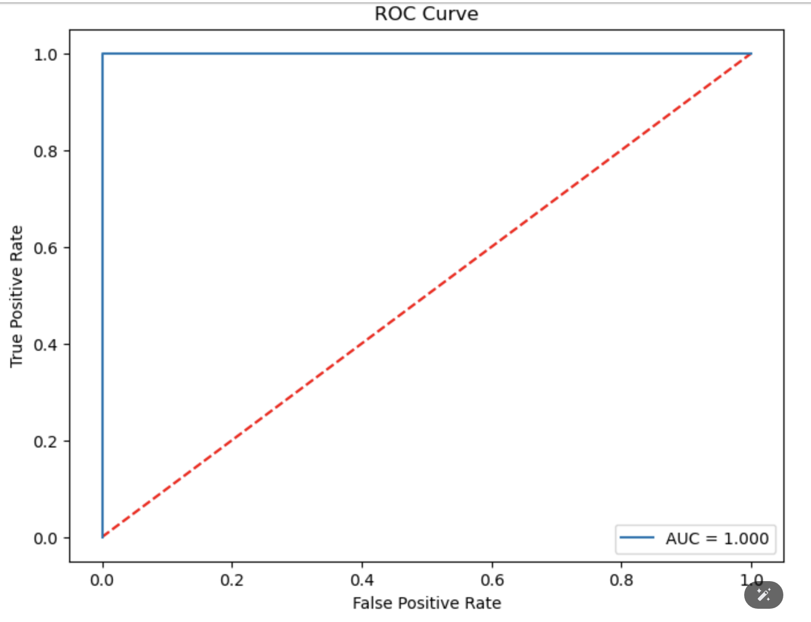
Fig 4 Confusion matrix
Fig 5 ROC Curve
Notes:
The Confusion Matrix shows perfect classification, with 200 True Positives and 200 True Negatives, indicating no misclassification. The ROC Curve with an AUC of 1.0 reflects excellent model performance in distinguishing between mask and no-mask cases."

Slide 13
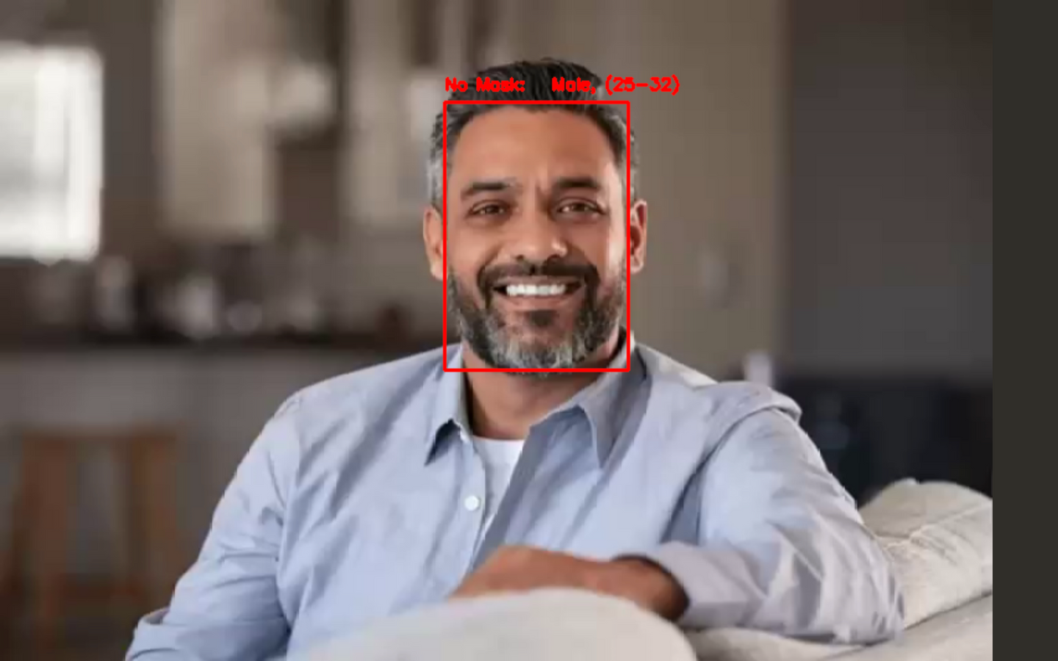
RESULTS
Fig 6 The model correctly identified the person as No Mask predicted their age group as 25-32 and gender as Male

Slide 14
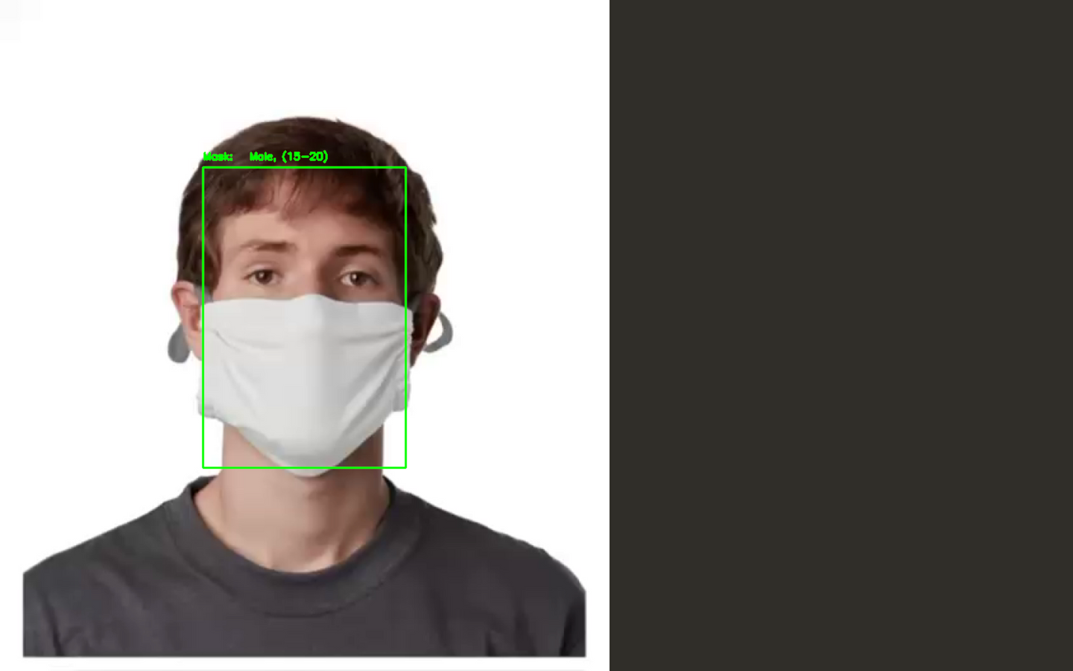
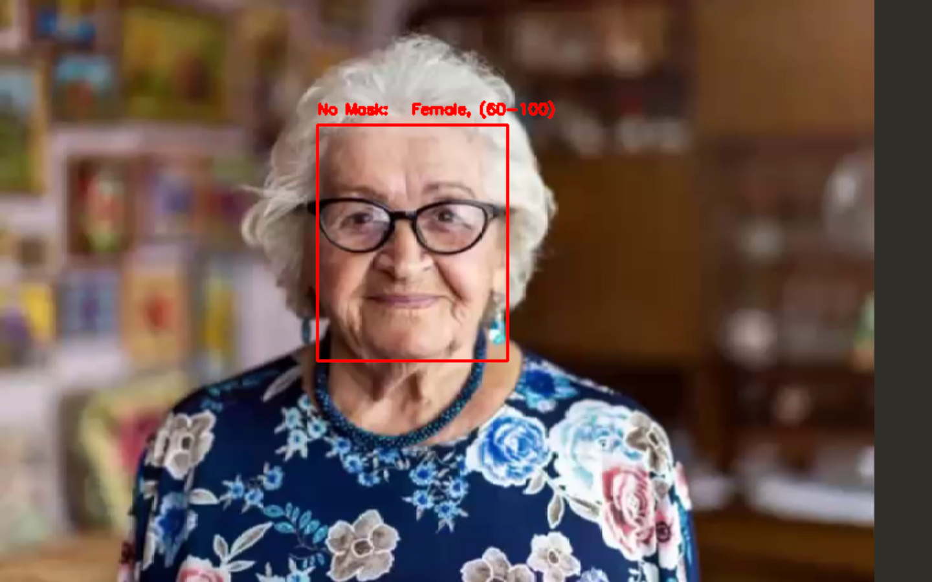
Fig 7 The model correctly identified the person as Mask predicted their age group as 15-20 and gender as Male
Fig 8 The model correctly identified the person as No Mask predicted their age group as 60-100 and gender as Female

Slide 15
CONCLUSION
The model demonstrates high accuracy in Realtime face mask, Age and gender classification, achieving 99.99% accuracy with minimal misclassifications.
It effectively identifies mask status, age group, and gender, offering robust performance across various metrics such as sensitivity, specificity, and AUC.
The integration of lightweight models ensures efficiency for real-time applications, making it ideal for practical use in diverse environments.
Notes:
The model achieves 98.75% accuracy in real-time face mask, age, and gender detection with minimal errors, performing well across key metrics like sensitivity, specificity, and AUC. Using lightweight models, it ensures efficient real-time performance, making it suitable for practical applications.

Slide 16
FUTURE SCOPE
This application can be enhanced by expanding the dataset to improve model generalization and accuracy across diverse populations.
Integration with additional demographic predictions, such as ethnicity or emotion detection, could further enrich its capabilities.
Additionally, optimizing the model for edge devices with real-time processing could make it more accessible for deployment in public health, security, and retail environments.
Notes:
To improve the model, we can expand the dataset to enhance its generalization across diverse populations. Adding features like ethnicity or emotion prediction will increase its capabilities. Optimizing the model for edge devices will make it more practical for real-time applications in areas such as public health, security, and retail.

Slide 17
REFERENCES
1.A Real-Time Face Mask Detection System Using Convolutional Neural Networks
This paper presents a face mask detection model for static and real-time videos, classifying images as “with mask” and “without mask.”
http://link.springer.com/article/10.1007/s11042-022-12166-x
2.Deep Learning Techniques for Detecting and Recognizing Face Masks
This article reviews Masked Face Recognition (MFR) and Occluded Face Recognition (OFR) deep learning algorithms and studies their effectiveness in detecting correct mask usage.
https://www.frontiersin.org/journals/public-health/articles/10.3389/fpubh.2022.955332/full
3.Face Mask Detection Using CNN
This paper introduces a deep learning computer vision model to recognize if a person visible through the camera is wearing a mask or not.
https://www.researchgate.net/publication/355347091_Face_Mask_Detection_Using_CNN

Slide 18
Q/A
1.How does the model generalize across different lighting and pose variations in real-world settings?
The model is trained on a diverse dataset with various lighting and pose conditions, supplemented by data augmentation techniques to ensure better generalization.
2.How does the model handle different mask types (e.g., cloth masks, surgical masks)?
The model is trained on various mask types, so it can differentiate between cloth and surgical masks, but performance may vary with uncommon mask designs.
3.What is the impact of dataset size on the model's performance?
A larger, more diverse dataset improves generalization, but the current dataset may lead to overfitting, which can be mitigated by data augmentation techniques.
4.How would you extend this project to work in crowded environments?
Adding multi-face detection and optimizing the real-time processing pipeline to handle multiple faces simultaneously would help in crowded environments.

Slide 19
Let’s look into the Source code implementation

Slide 20
THANK YOU

